Slide 1

CERAMIC PIEZOELECTRIC TRANSDUCERS

Slide 2
TEAM MEMBERS
RAKESH BOMMA
JATIN NAGA DATTA SAI SARAN
REVANTH ANUMUKONDA
SAI CHANDU ALUGULA
SAI SRUJANA KOTTE
ABHISHEK DUBASI

Slide 3

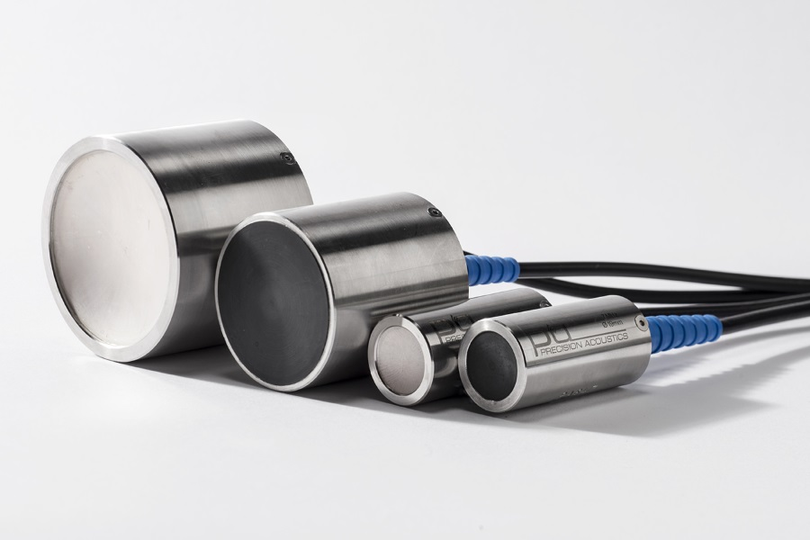
INTRODUCTION
Ceramic piezoelectric transducers, also called piezoceramics, belong to a class of electronic components that are distinguished by their exceptional capability of converting mechanical motion from electrical energy and vice versa.
This feature results from the inherent ability of some ceramic materials to produce an electrical charge in response to mechanical stress or, on the other hand, to mechanically deform in response to an applied electrical voltage. This phenomenon is known as the piezoelectric effect.
These transducers are crafted from ceramic materials possessing a perovskite structure, with lead zirconate titanate (PZT) and barium titanate being prominent choices due to their robust piezoelectric characteristics.
https://www.acoustics.co.uk/wp-content/uploads/2016/05/piezoceramic-transducers.jpg

Slide 4
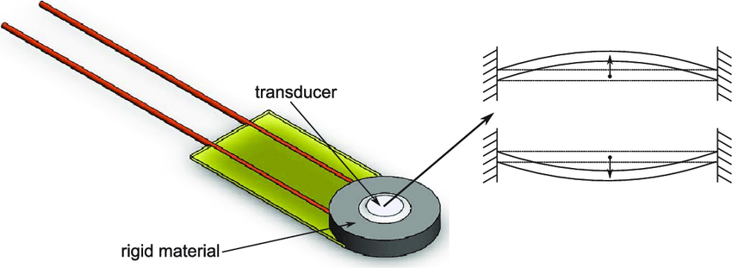
INTRODUCTION
The fundamental principle behind their operation is relatively straightforward: when an electrical voltage is applied across the ceramic material, it triggers a change in its shape, leading to mechanical deformation. Conversely, when mechanical force or pressure is applied to the ceramic, it generates an electrical charge.
Lead zirconate titanate (PZT) is a common ceramic used for its strong piezoelectric properties. Typically, the ceramic is sandwiched between electrodes to facilitate the electrical connection
https://www.researchgate.net/publication/305509510/figure/fig2/AS:1011880017555458@1618262404404/Structure-of-the-piezoelectric-ceramic-disk-and-vibration-of-the-transducer.png

Slide 5
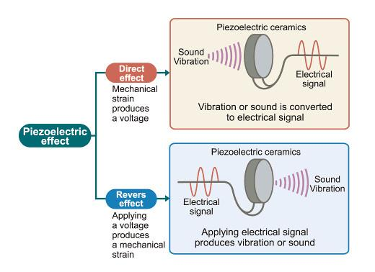
PIEZOELECTRIC EFFECT
There are certain materials that generate electric potential or voltage when a mechanical strain is applied to them or vise versa this effect is known as piezoelectric effect
It means that when the crystal is subjected to an external force in a fixed direction, the internal phenomenon is generated, and at the same time, opposite signs are generated on one of the two surfaces, when the external force is removed, the crystal returns to the uncharged state
https://www.he-shuai.com/wp-content/uploads/2021/02/piezoelectric-effect-.jpg

Slide 6
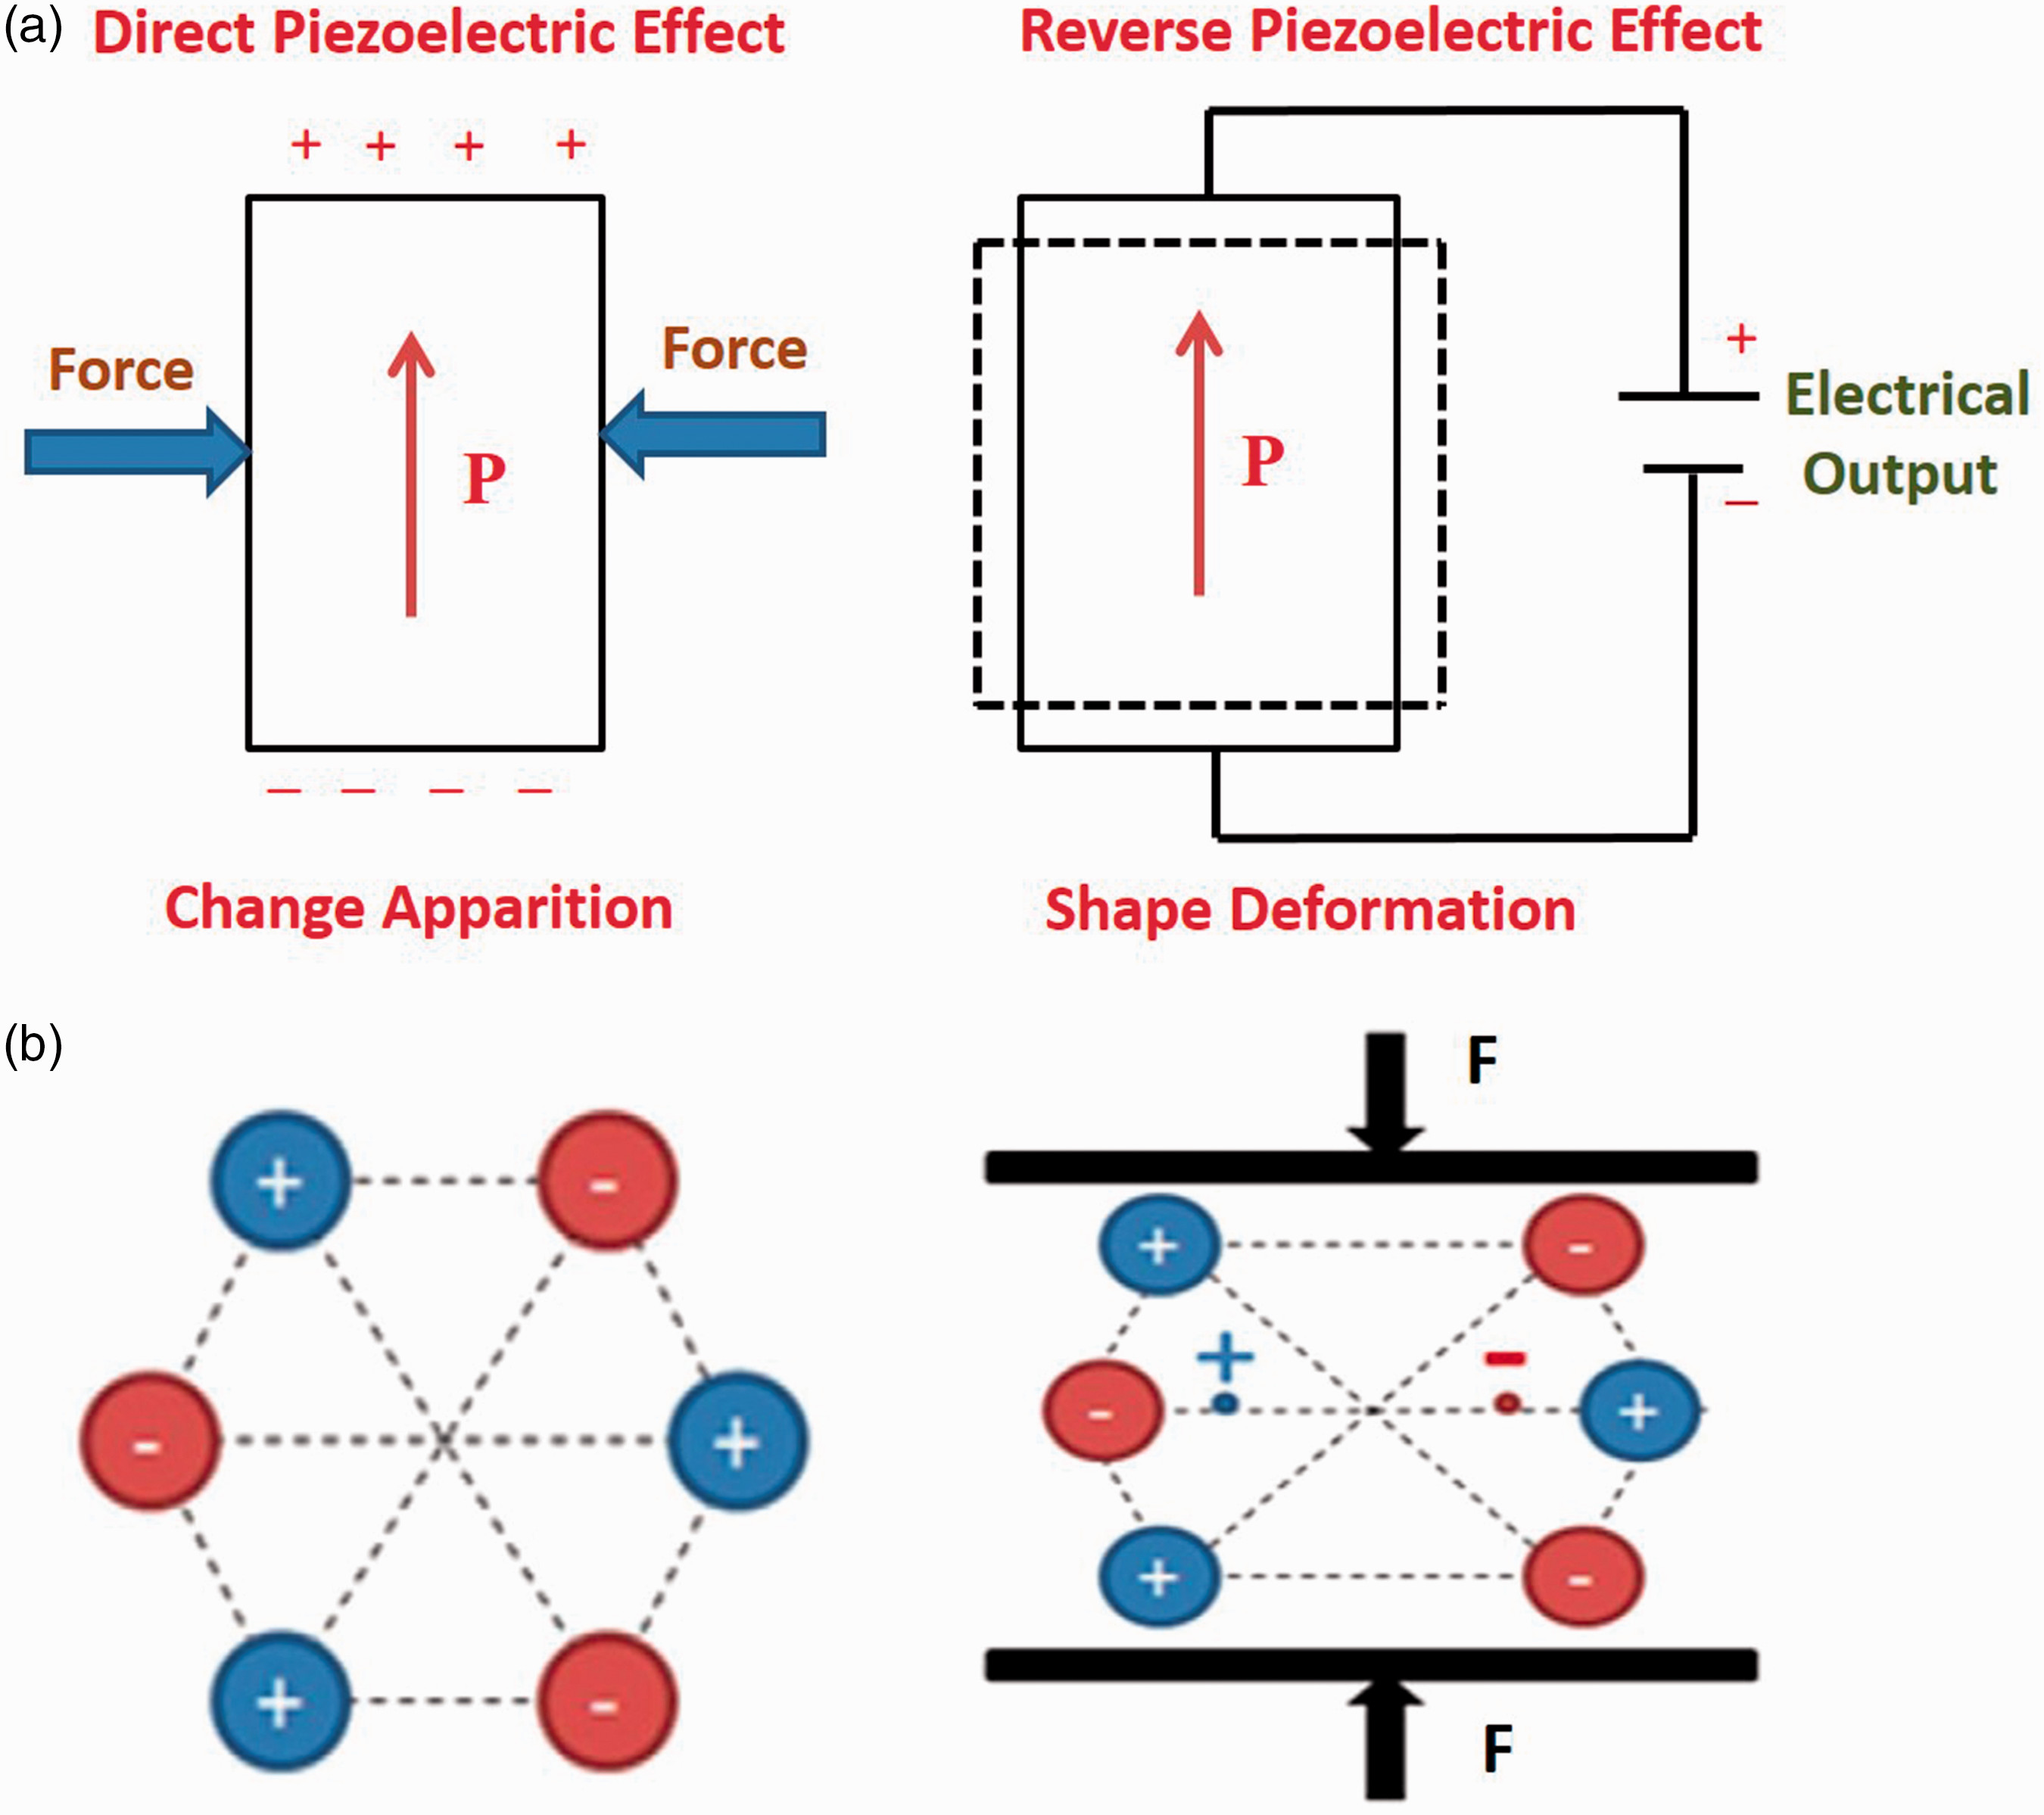
WORKING PRINCIPLE
Piezoelectric Transducer works with the principle of piezoelectricity. The faces of piezoelectric material, usually quartz, are coated with a thin layer of conducting material such as silver.
When stress is applied the ions in the material move towards one of the conducting surfaces while moving away from the other. This results in the generation of charge. This charge is used for the calibration of stress.
The polarity of the produced charge depends upon the direction of the applied stress. Stress can be applied in two forms Compressive stress and Tensile stress as shown below.
https://journals.sagepub.com/cms/10.1177/1528083719870197/asset/images/large/10.1177_1528083719870197-fig1.jpeg

Slide 7
EXAMPLES
SYNTHETIC PIEZO-CERAMICS
Barium titanate (BaTiO3)
Lead-zirconate-titanate (Pb[ZrxTi1−x]O3, 0 ≤ x ≤ 1)
Lead lanthanum Zirconate titanate (PLZT)
Sodium tungstate (Na2WO3)
Ba2NaNb5O5
Pb2KNb5O15
Zinc oxide (ZnO)
Potassium niobate (KNbO3)
LEAD FREE PIEZO-CERAMICS
Potassium–sodium niobate ((K,Na)NbO3)
Bismuth sodium titanate (Bi0.5Na0.5)TiO3
Bismuth ferrite (BiFeO3)
Bismuth titanate (Bi4Ti3O12)

Slide 8
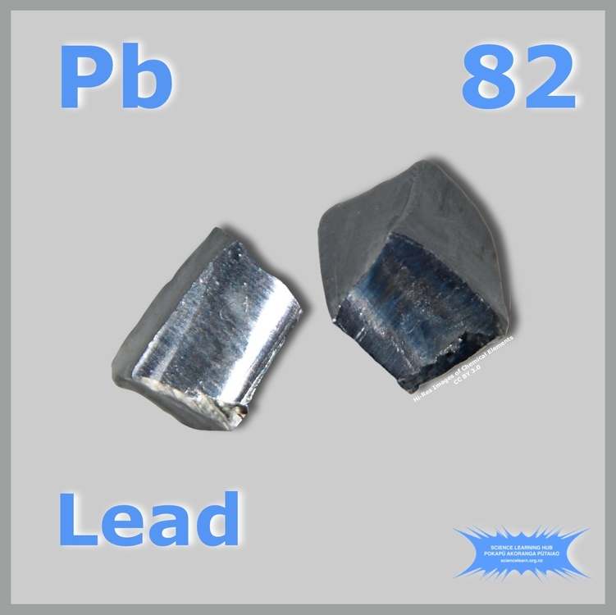
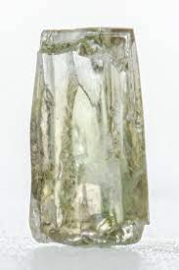
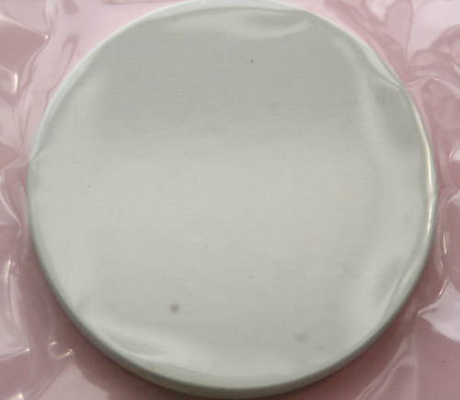



Ongoing Research and Advancements in Ceramic Piezoelectric Transducers
Lead-based materials used in electronics are causing global concerns due to their toxicity.
Recent research focuses on lead-free alternatives like BaTiO3 (BT), (Bi0.5Na0.5)TiO3 (BNT), and (K0.5,Na0.5)NbO3 (KNN), showing good piezoelectric activity. Modifications with BaZrO3 and (Bi0.5,K0.5)HfO3 enhance their properties, providing hope for safer options.
Ongoing development in lead-free materials is getting us closer to practical use, especially in creating reproducible lead-free piezoelectric compositions for various applications, including low- to high-power transducers.
https://www.sciencelearn.org.nz/images/3985-elemental-lead
https://surfacenet.de/bilder/kristalle/Barium-Zirkonate-0231.jpg
https://en.wikipedia.org/wiki/File:BaTiO3ceramics.JPG

Slide 9
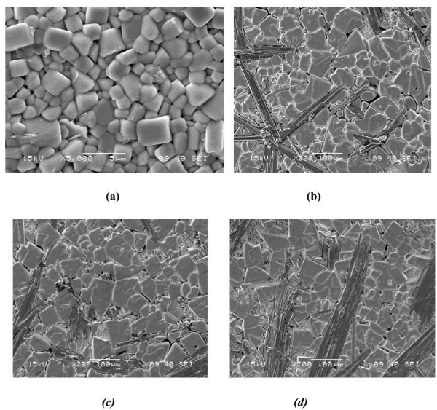
Lead-based ceramics, like PZT, are widely used in ultrasonic devices, but their high lead content raises environmental concerns.
To address this, there's a need for eco-friendly alternatives. The Na0.5Bi0.5TiO3–xBaTiO3 (NBT–xBT or NBT–BT) solid solution is a promising lead-free option with strong piezoelectric properties. NBT–BT single crystals have potential in medical imaging and non-destructive evaluation.
Modified PZT/epoxy composites enhance properties. Lead-free NBT–BT single crystal-based ultrasonic transducers offer a safer alternative for various applications.
https://www.researchgate.net/figure/SEM-images-of-a-Al2O3-sintered-at-1400C-for-30min-with-ZnF2-TiO2-and-La2O3-ternary_fig1_313843869
Scanning electron microscope (SEM) of
NBT
0.96NBT-0.04BT
0.096NBT-0.06BT
(d) 0.092NBT-0.08BT Sintered at 1150 C

Slide 10
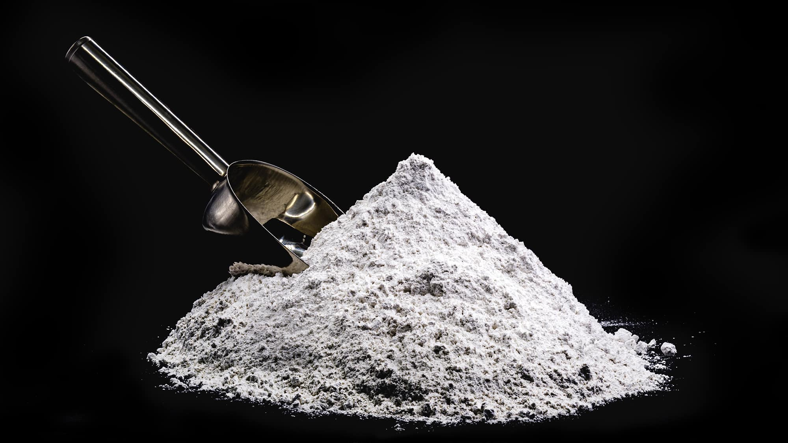
Scientists are keen on using piezoelectric transducer technology to harvest energy and create electricity. Lead zirconate titanate, a common but environmentally problematic material, is being replaced by lead-free alternatives like zinc oxide and barium titanate.
To enhance these lead-free materials for energy harvesting, scientists are adding nanodielectric fillers using a technique called spark plasma sintering. However, there's a need for more research to improve the properties of lead-free materials such as BaTiO3.
The recommendation is to use nanoparticles with specific characteristics to enhance the performance of piezoelectric transducer components.
Zinc Oxide (ZnO)
https://www.google.com/url?sa=i&url=https%3A%2F%2Fwww.indiamart.com%2Fproddetail%2Fzinc-oxide-nanopowder-23724462033.html&psig=AOvVaw25ymtJ3OWeww5WRPCP78pY&ust=1706016235985000&source=images&cd=vfe&opi=89978449&ved=0CBMQjRxqFwoTCMja8vWL8YMDFQAAAAAdAAAAABAD

Slide 11
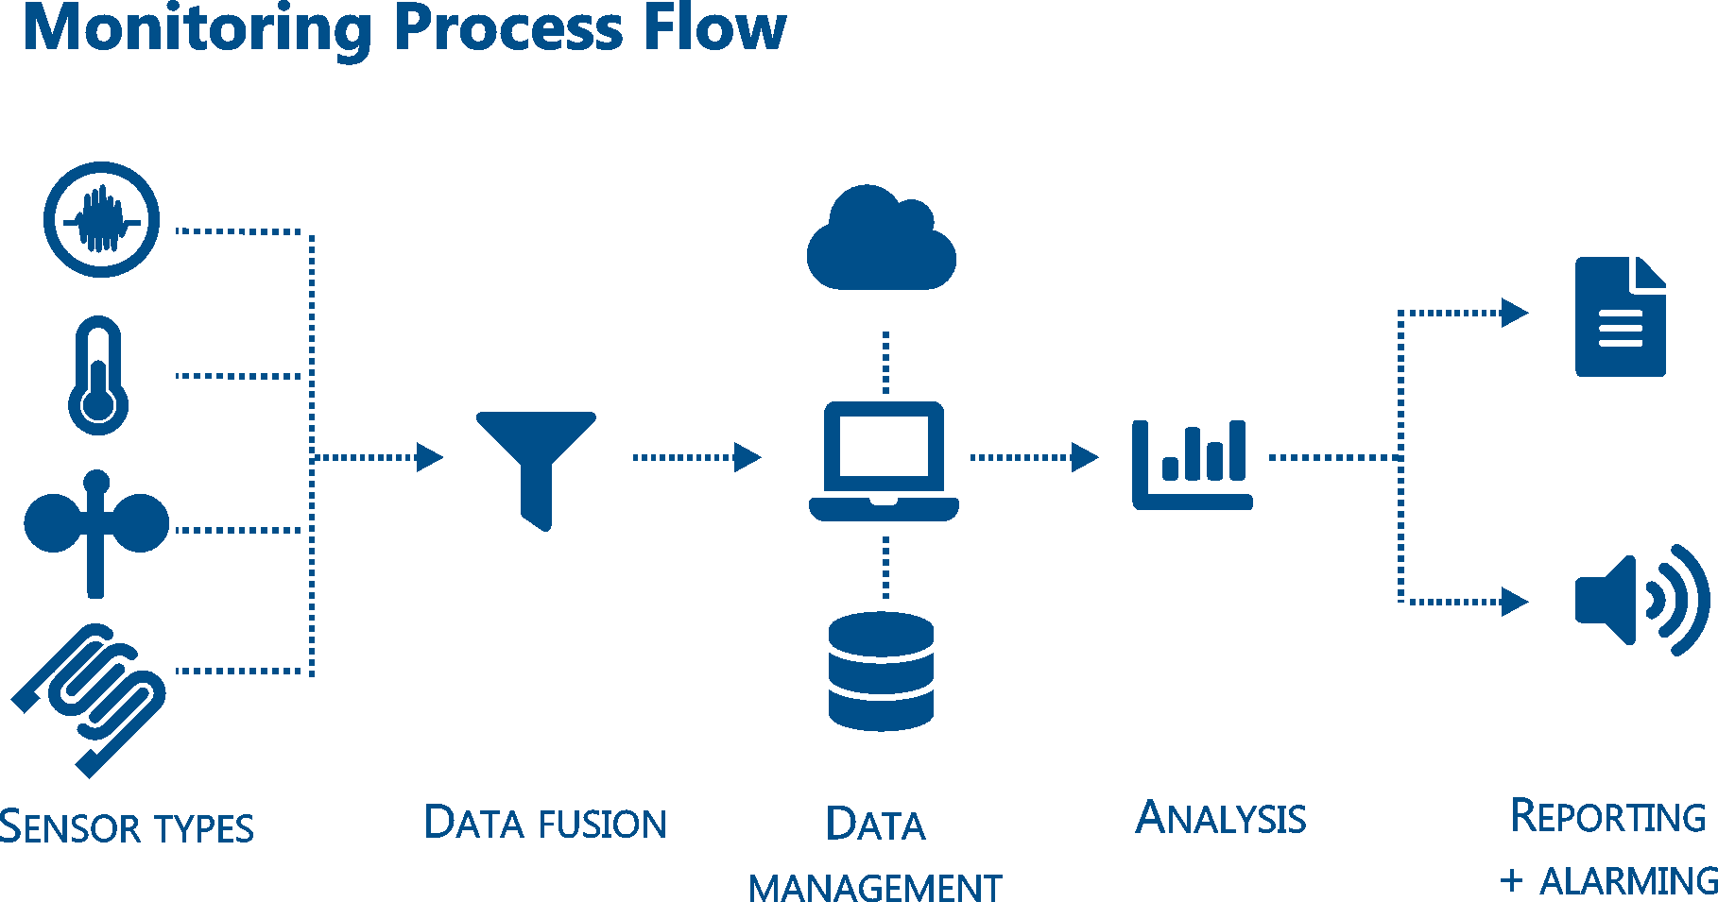
Structural Health Monitoring (SHM) is an emerging technology that combines various disciplines. Piezoelectric materials, known for their advantages like being lightweight and cost-effective, have become essential in SHM systems.
Traditional piezoelectric sensors, while widely used, have limitations such as brittleness and difficulty in covering curved surfaces, compromising reliability.
The focus is on developing a new smart material - the distributed piezoelectric transducer, specifically a flexible piezoelectric composite known as piezoelectric paint. The research aims to create a high-quality piezoelectric paint, addressing its main drawback of low piezoelectricity.
https://www.vallen.de/wp-content/uploads/2019/06/Process_Flow_6.png

Slide 12
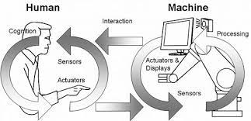
Advances in sensing and information tech have led to interest in smart flexible electronics, especially in AI and human-machine interactions.
Traditional devices are rigid, limiting wearability and impacting user experiences. Researchers are exploring flexible devices with enhanced stretchability for health monitoring and gestures.
These devices can conform to various shapes, enabling real-time monitoring. Human-machine sensors based on the piezoelectric effect, known for sensitivity, are widely used for tactile sensing.
The inverse piezoelectric effect allows these materials to deform under an electric field, enabling the creation of all-in-one devices with sensing and actuation functions.
https://www.researchgate.net/profile/Mirza-Abdur-Razzaq/publication/318890215/figure/fig1/AS:523444275748864@1501810248176/Example-of-human-machine-interaction.png

Slide 13
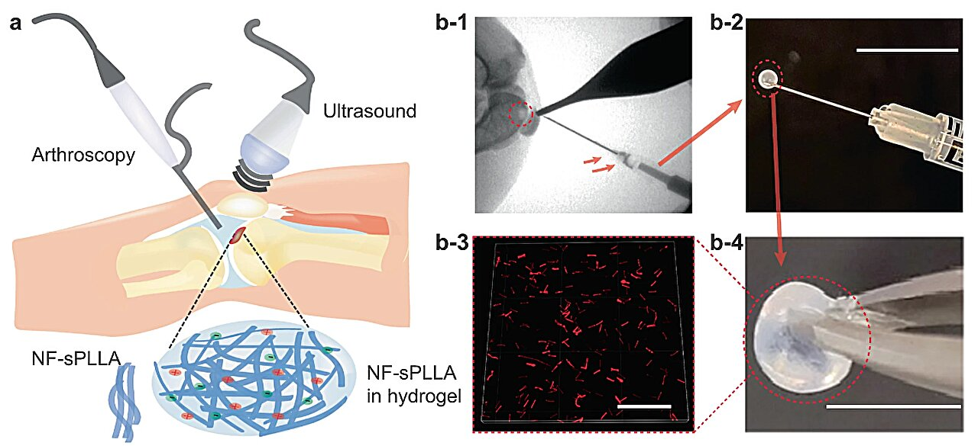
To power advanced bioelectronics, we need flexible, biocompatible energy sources. Traditional batteries have limitations, so there's a demand for new, soft, and biodegradable energy-harvesting materials.
Piezo Gels, a type of smart crystalline gel, generate electricity when stressed. Like hydrogels, Piezo Gels are flexible, biocompatible, and biodegradable, suitable for power generation, sensing, and biomedical uses.
Recent efforts focus on Piezoelectric Generators (PEGs) with lightweight, flexible, and easily made devices, essential for cost-effective and versatile powered devices.
https://scx1.b-cdn.net/csz/news/800a/2023/gel-repairs-cartilage-1.jpg

Slide 14
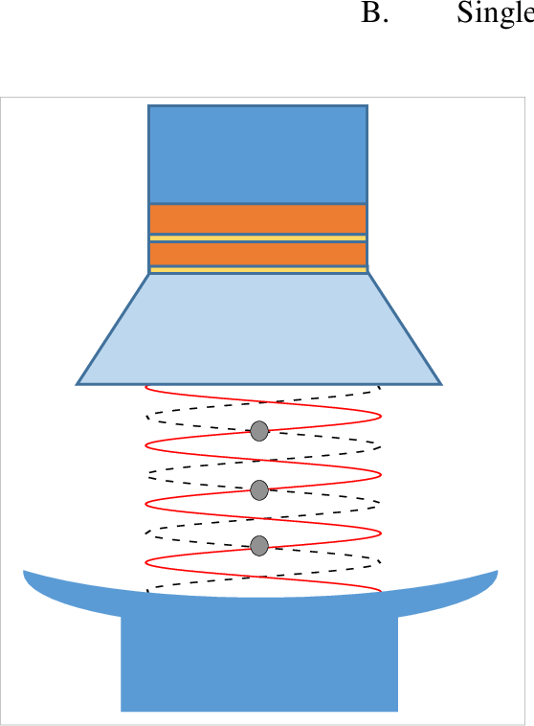
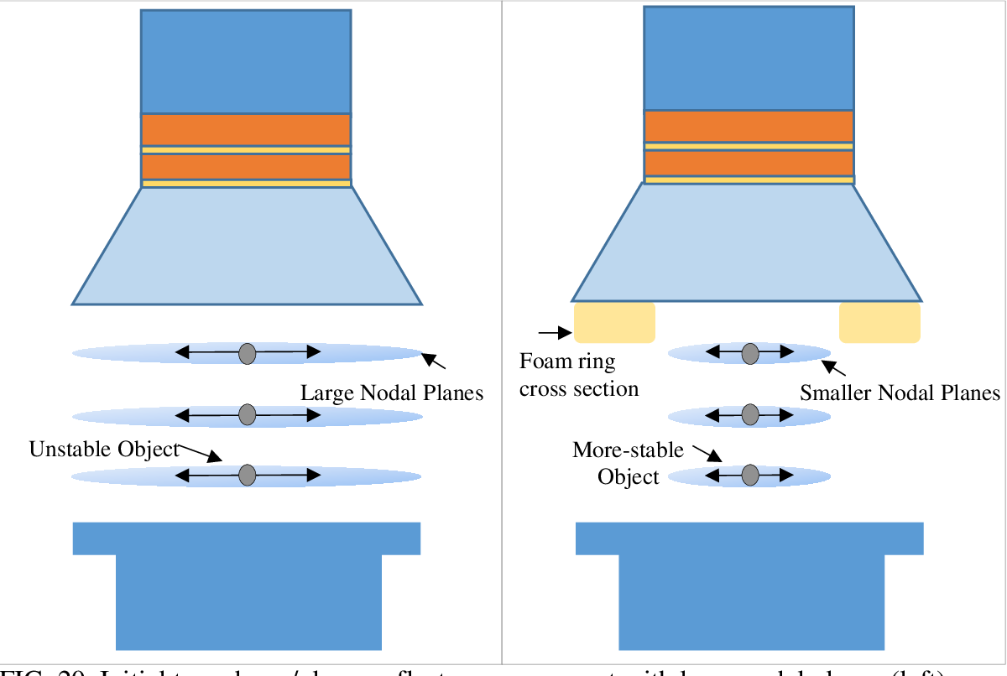
High-power ultrasonics and underwater acoustics use composite piezoelectric ceramic transducers like the Langevin type.
In ultrasonic liquid processing, especially for high-power needs, new large power radial vibration ultrasonic transducers are being explored. These transducers, made of metal and a piezoelectric ceramic ring, emit ultrasonic energy radially. Compared to tubular radiators, a ring-type radial composite piezoelectric ceramic transducer has a smaller sound-radiating area.
Another design, the cylindrical radial composite piezoelectric ceramic transducer, with a metal shell and a radially polarized piezoelectric ceramic tube, has a larger sound-radiating area. Researchers are studying its radial vibration characteristics and electro-mechanical properties for applications in ultrasonics and acoustics.
Lengavin Transducer
https://d3i71xaburhd42.cloudfront.net/e226c92dad6532537d2df720c0e6a943978d5ceb/250px/17-Figure1-1.png

Slide 15

MATLAB CODE

Slide 16
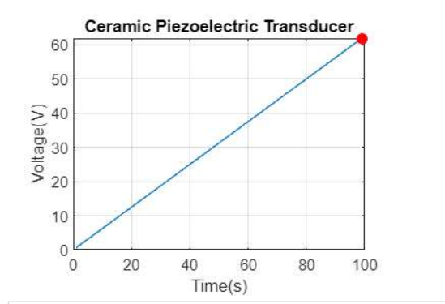
GRAPH
Subtitle

Slide 17
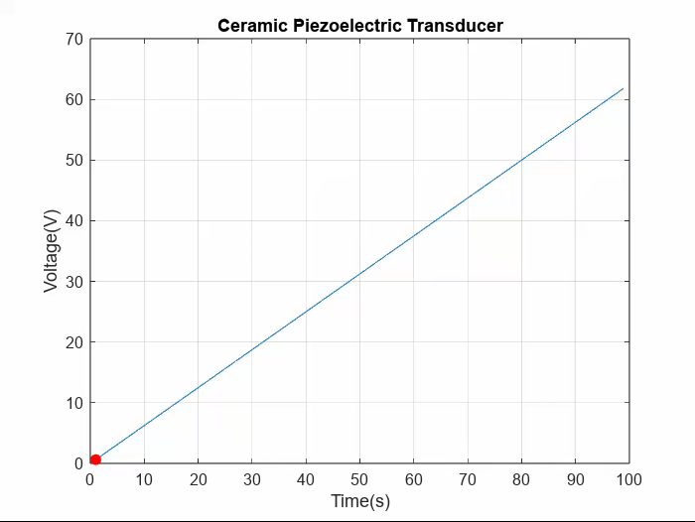
GRAPH SIMULATION

Slide 18
ADVANTAGES AND LIMITATIONS

Slide 19
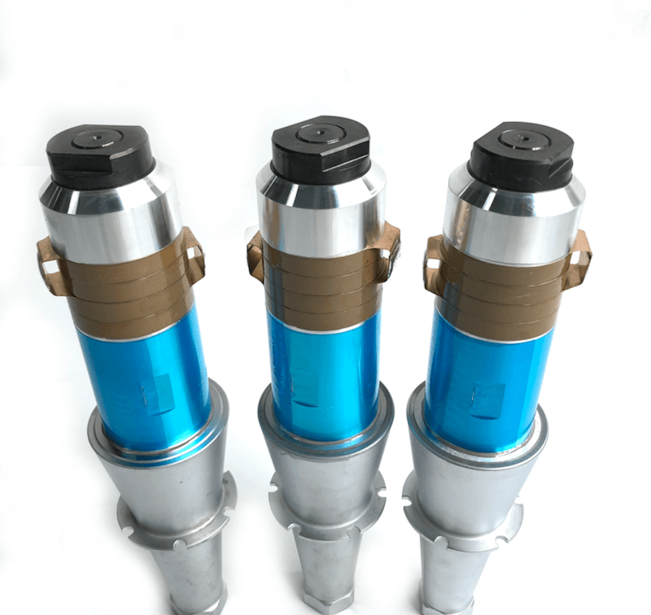
Advantages:
The high-frequency reaction of these piezoelectric transducers makes them a perfect choice for different applications because some parameters in these applications change too quickly.
They have a rapid response time, making them suitable for applications that require quick and precise control, such as in inkjet printers or certain types of actuators.
These materials are often durable and withstand harsh environmental conditions, making them suitable for various industrial applications.
Piezoelectric materials can operate over a broad frequency range, making them versatile for various applications including sensors, actuators, and energy harvesting devices.
They are available in desired shape.
They are easy to handle and utilize due to their small dimensions.
https://images.app.goo.gl/baxXdQeZK1fsTrZr5

Slide 20
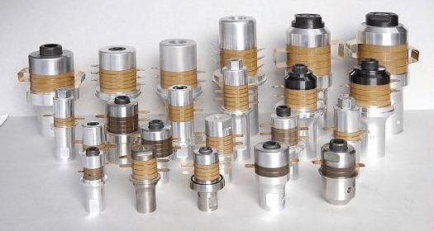
Limitations :
The performance of piezoelectric materials can be affected by temperature changes, which may require additional compensation or control mechanisms. Some crystals are water soluble and dissolve in highly humid environment
The output obtained from the piezoelectric transducers is low, so an external electronic circuit must be connected.
Piezoelectric Transducers can only measure dynamic pressure and are useless for measuring static parameters.
These require complex design and manufacturing processes, which can increase their cost and make them difficult to produce in large quantities.
They typically have limited displacement, which may restrict their use in applications that require large mechanical movements.
https://images.app.goo.gl/LSoavYQ1MS6eniAZ8

Slide 21
Future Aspects of Ceramic Piezoelectric Transducer

Slide 22
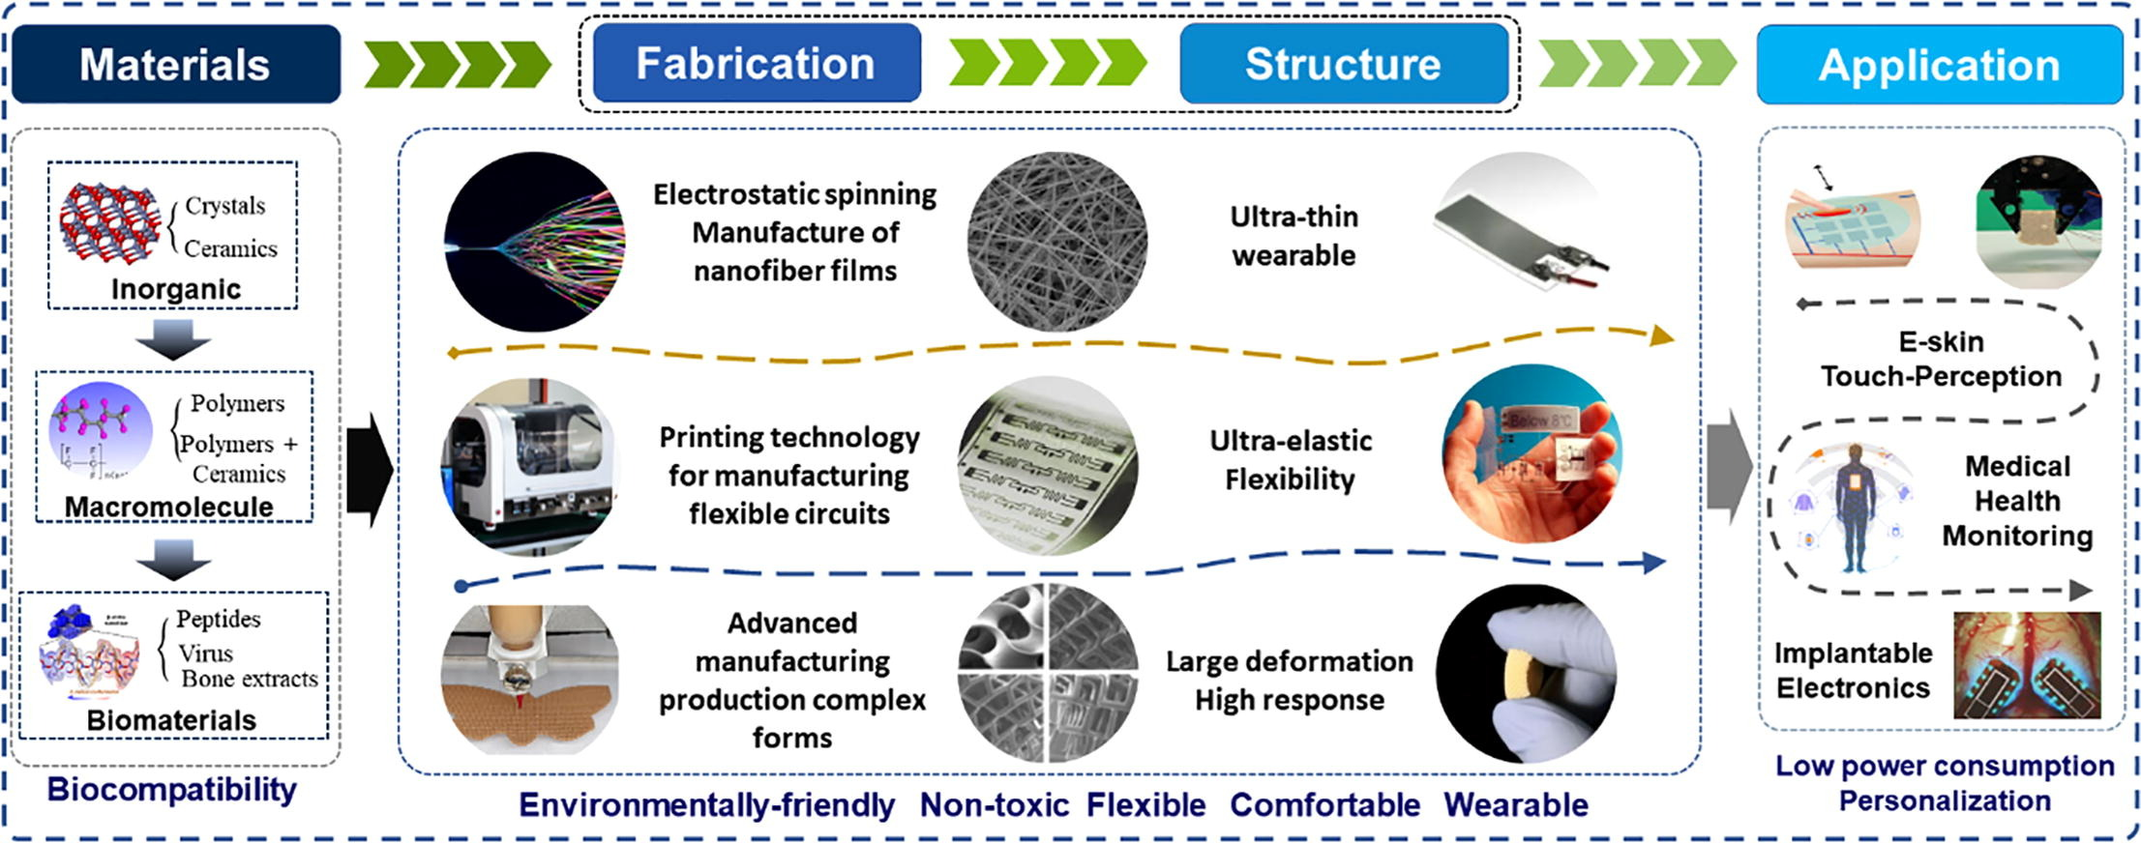
Ceramic piezoelectric transducers have several potential future aspects and developments, reflecting the ongoing research and technological advancements in this field. Here are some of the key future aspects to consider:-
Material Advancements: Research is likely to focus on developing new ceramic materials with enhanced piezoelectric properties. This could include higher piezoelectric coefficients, greater mechanical strength, and better thermal stability. The development of lead-free piezoceramics is also a significant area of research, driven by environmental concerns.
https://www.sciencedirect.com/science/article/pii/S026412752100719X

Slide 23
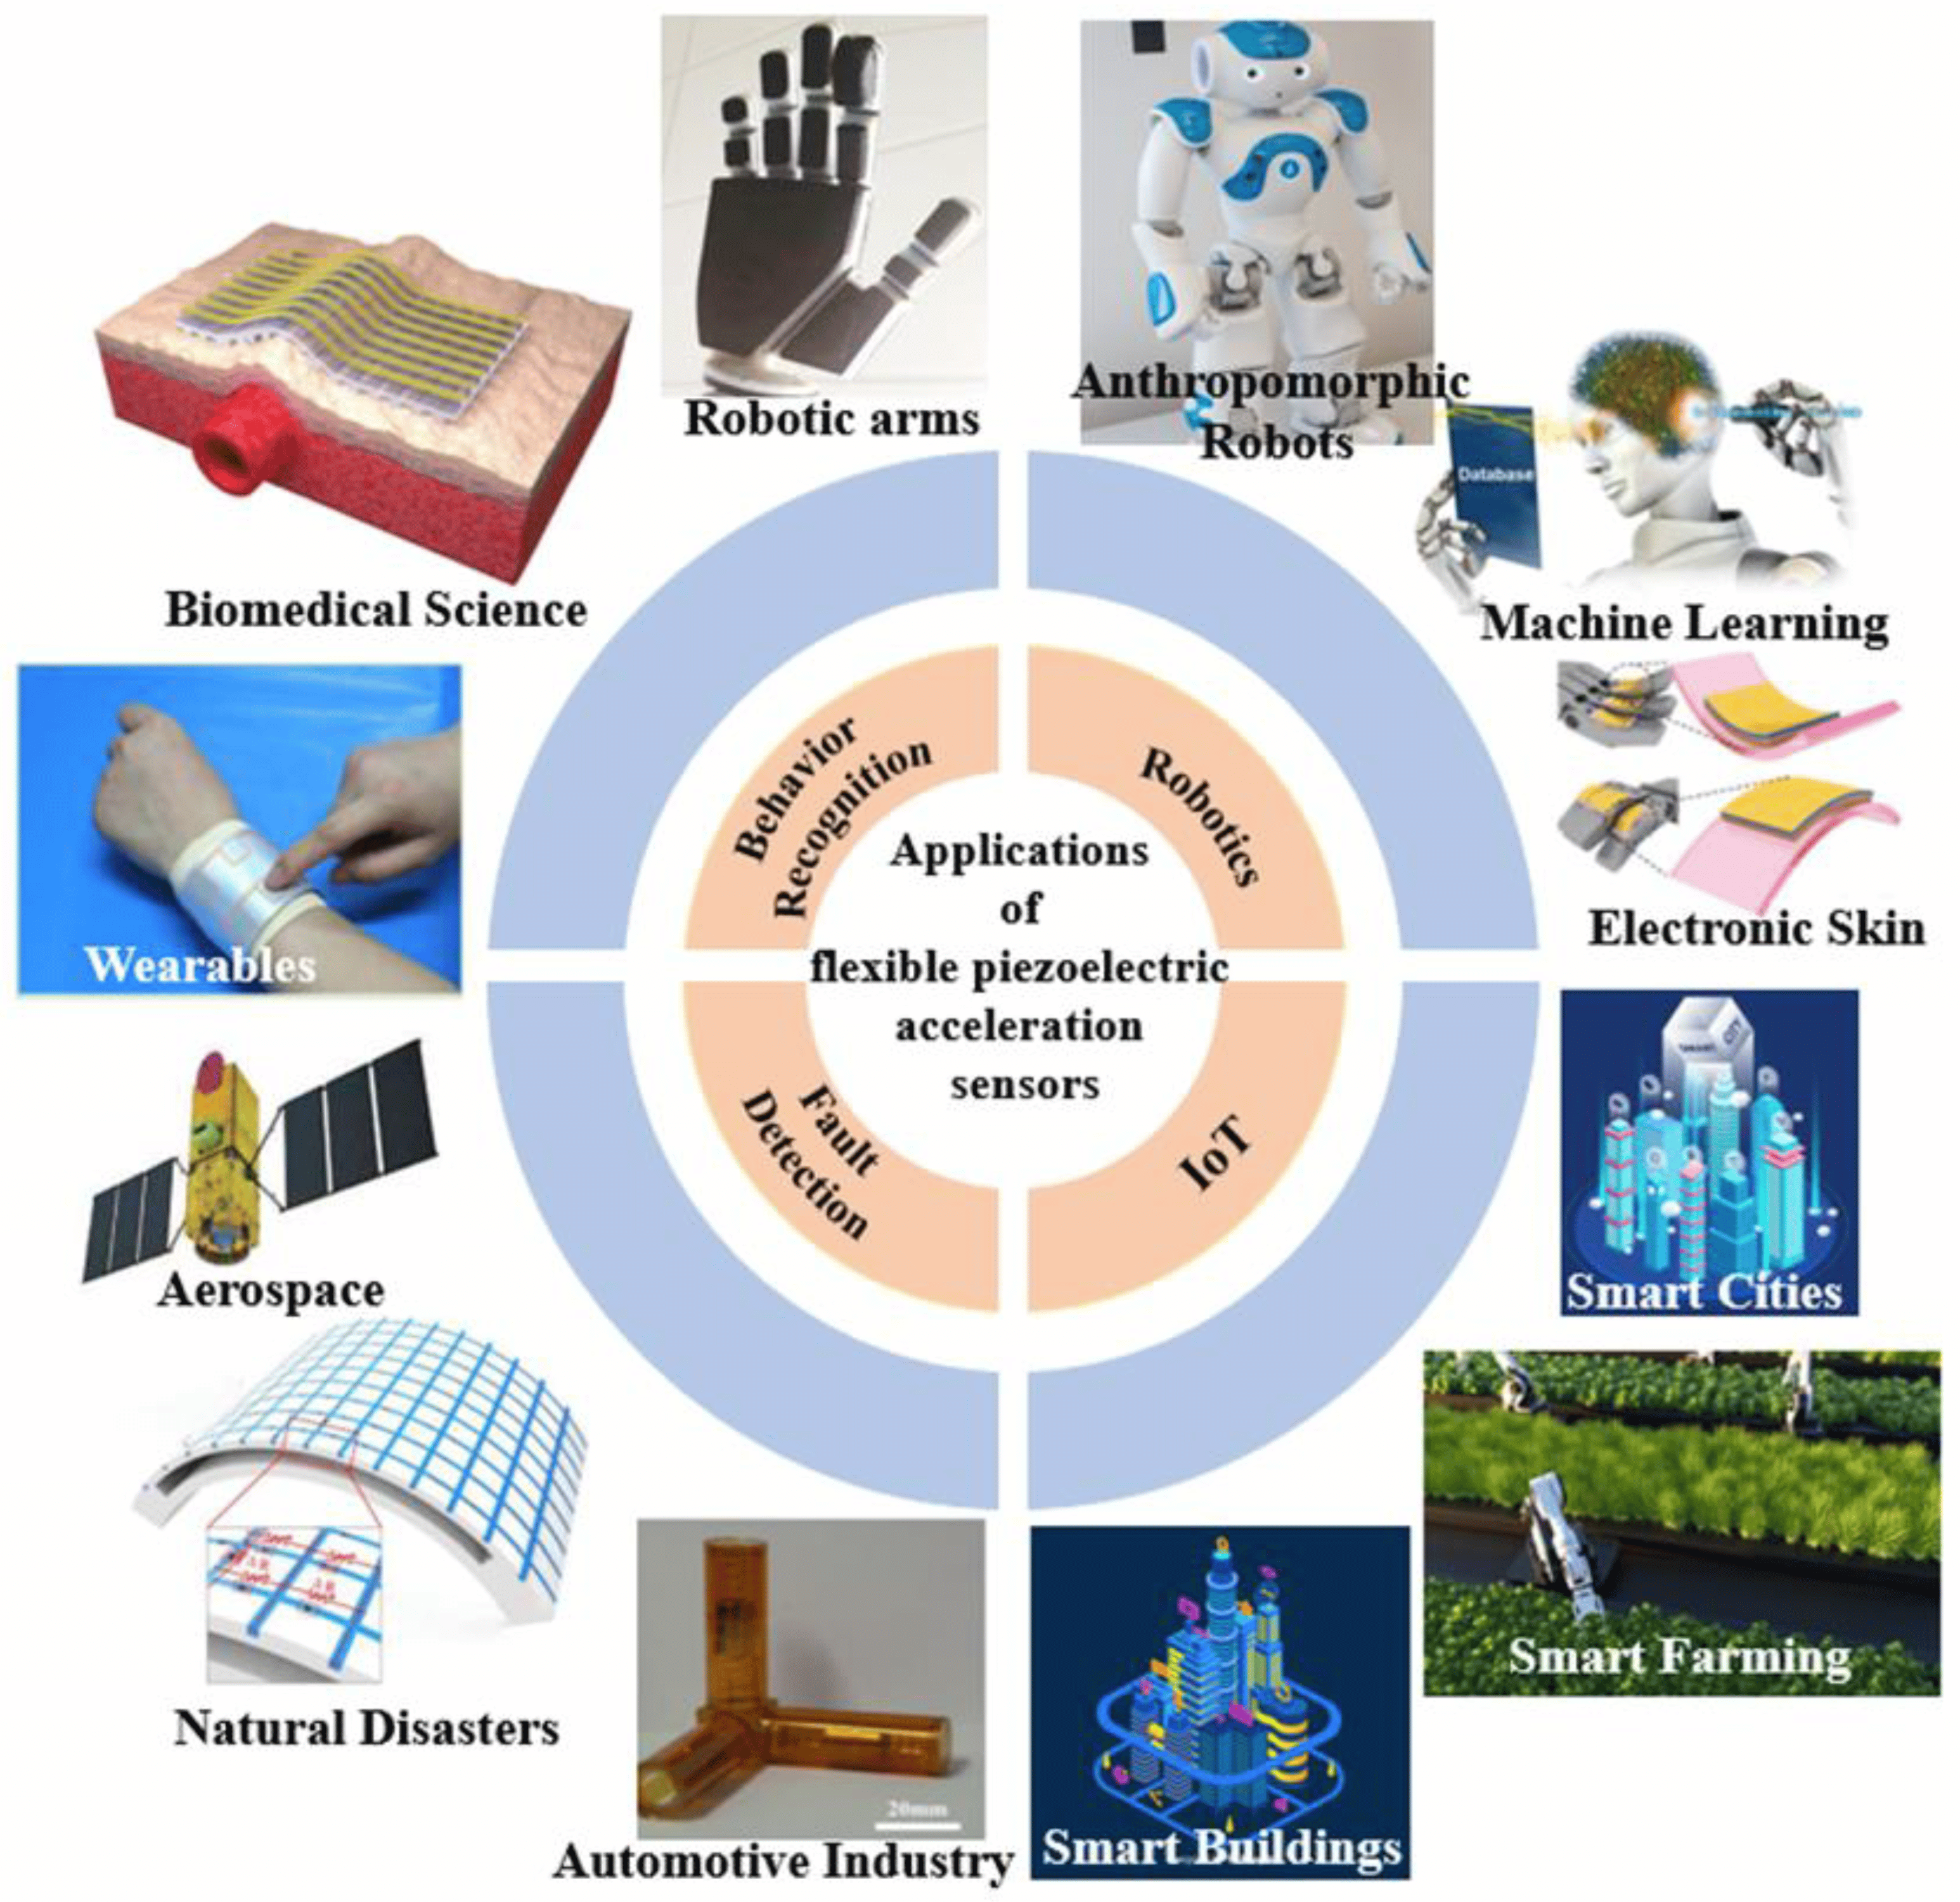
Miniaturization and Integration: As electronic devices continue to shrink in size, there will be a push towards miniaturizing ceramic piezoelectric transducers without compromising their performance. This miniaturization will facilitate their integration into a broader range of applications, including wearable technology, biomedical devices, and micro-electromechanical systems (MEMS).
Energy Harvesting Applications: The use of ceramic piezoelectric transducers for energy harvesting from ambient sources (like vibrations, sound waves, or fluid flows) is expected to grow. This could lead to self-powered sensors and devices, particularly valuable for remote or inaccessible locations.

Slide 24

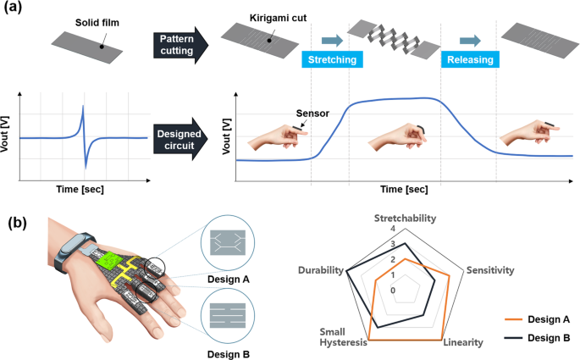
Improved Sensing Capabilities: Advances in ceramic piezoelectric transducers are likely to lead to improved sensors with higher sensitivity, better signal-to-noise ratios, and enhanced reliability. These could be crucial in applications like medical diagnostics, structural health monitoring, and environmental sensing.
Smart Systems Integration: There will be a trend towards integrating ceramic piezoelectric transducers with smart systems, enabling real-time data collection, processing, and response. This integration could be vital in creating intelligent infrastructure and smart devices.
https://ssi-master.eu/ssiplus/

Slide 25
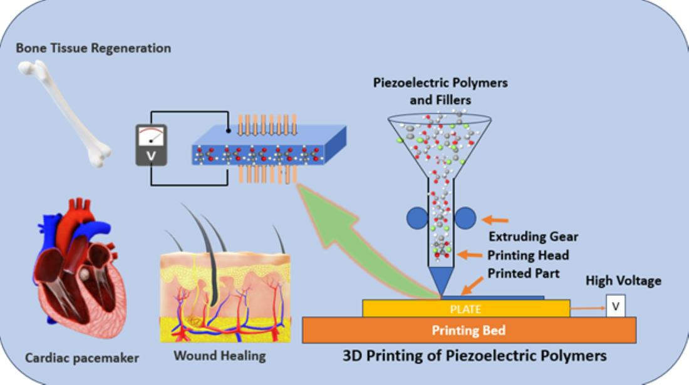
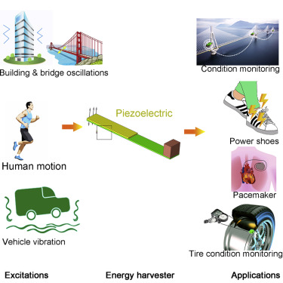
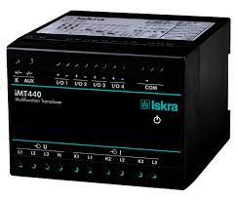
Enhanced Manufacturing Techniques: Advancements in manufacturing processes, like 3D printing or advanced sintering techniques, may allow for more complex and precisely engineered ceramic piezoelectric transducers. This could lead to better performance and more cost-effective production methods.
Environmental and Safety Considerations: Future developments will also need to address environmental and safety concerns, particularly related to the disposal and recycling of piezoelectric materials, as well as the potential health impacts of long-term exposure to certain materials.
Multi-functional Transducer
https://www.researchgate.net/publication/324426785_High-Performance_Piezoelectric_Energy_Harvesters_and_Their_Applications

Slide 26
CONCLUSION
In conclusion, ceramic piezoelectric transducers represent a significant and versatile technology in modern engineering and electronics. These devices, which leverage the piezoelectric properties of certain ceramic materials to convert mechanical energy into electrical energy and vice versa, have a wide array of applications ranging from medical ultrasound imaging to industrial sensors and actuators.
The key advantages of ceramic piezoelectric transducers include their high piezoelectric constants, which result in excellent electromechanical coupling efficiency, their robustness, and their ability to operate over a wide range of temperatures and frequencies. These characteristics make them highly suitable for demanding environments and applications where reliability and precision are crucial.
Moreover, advancements in materials science have led to the development of new ceramic piezoelectric materials that are more efficient, environmentally friendly, and suitable for specialized applications. The ongoing research in this field is expected to further enhance the performance and expand the applicability of these transducers.

Slide 27
REFERENCES
[1]. Ahmad Safari, Qifa Zhou, Yushun Zeng, and Jack D. Leber. Advances in the development of Pb-free piezoelectric materials for transducer applications. Published by Japanese Journal of Applied Physics – 2023.
[2]. Dan Zhou, Kwok Ho Lam, Yan Chen, Qinhui Zhang, Yat Ching Chiu, HaosU Luo, Jiyan Dai, Helen Lai Wa Chan. Lead-free piezoelectric single crystal based 1–3 composites for ultrasonic transducer applications. Published by Elsevier B.V-2012.
[3]. V. E. Ogbonna, A. P. I. Popoola and O. M. Popoola. Piezoelectric ceramic materials on transducer technology for energy harvesting. Published by Frontiers in Energy Research -22 December 2022.
[4]. Thangavel Vijayakanth, Sudha Shankar, Gal Finkelstein-Zuta, Sigal Rencus-Lazar, Sharon Gilead and Ehud Gazit. Perspectives on recent advancements in energy harvesting, sensing, and bio-medical applications of piezoelectric gels. Published by Chem Soc Rev - 20th April 2023.
[5]. Cheng Yang. Distributed Piezoelectric Transducers and Their Applications in Structural Health Monitoring. Published by Universität Siegen – 2017.
[6]. Jiaqing Liu, Guo Tian, Weiqing Yang, Weili Deng. Recent progress in flexible piezoelectric devices toward human-machine interactions. Published by Soft Science - 19 Dec 2022.
[7]. Shiqing Liua, Shuyu Lin. The analysis of the electro-mechanical model of the cylindrical radial composite piezoelectric ceramic transducer. Published by Elsevier – Sep 2009

Slide 28


Thank You

